Slide 1

Quick
Program
Overview
Current Team
Future Plans
Funding Sources
Community Partners
Documentation

Slide 2

Mission Statement
“to Find unique solutions for patients with unique needs”

Slide 3
Program Overview- Current Team
Fred Hector
Deputy Fire Chief
Neliah Williams
Community Resource Nav.
“Chief of Staff”
Referrals
Walter “Wally”
Kristy Capps
RN Navigator
Travis Maiuri
Firefighter/EMT
Day 911 Call Diversion
Visit Escort
ARNPs
Psychiatric
Primary Care
Certified Peer Specialist?
Not yet funded
SUD/Legal System
Medical Resource Technicians
(Sept. 26)
Cody Maine
CARES/MIH Captain
ARNPs/LAIs/Meds
Chronic Health
PCP Liaison
Shift Level MIH
MOUD
911 Call Diversion

Slide 4

Medical
Resource
Technicians
(MRT)
“We pity the fools”
Who abuse and misuse emergency services

Slide 5
Program Overview-
Medical Resource Technicians
Shift level extension of CARES
Specialized resource for MOUD, SUD, BH, social related calls, alternative transport.
Absorb low acuity calls from Engine Companies and Medic Units
Supplement and Augment response to critical and complex calls
Has a unique level of autonomy on shift level
Provide dynamic and specialized response capabilities
Funding by the BJA/HCA COSSUP Grant, (projected start August-September 26)

Slide 6
Program Overview- Funding Sources
Greater Health Now- Mobile Integrated Health - $228,000
  Training and Resiliency Support Program- $70,000
UW School of Social Work BH-CORE- $270,000
BJA/HCA COSSUP- $500,000
Walla Walla County 1/10 of 1% BH funds- $250,000 per year for 3 years
Walla Walla County Opioid Abatement funds- $150,000
Opioid Settlement funds- $81,000
AWC Alternative Response Team grant- pending request $245,000

Slide 7
Program overview- Community partners
Walla Walla Alliance for the Homeless
Christian Aid Center
Blue Mountain Heart to Heart
Blue Mountain Action Council
Comprehensive Healthcare
Walla Walla County Department of Community Health
Adult Protective Services
Aging and Long-Term Care

Slide 8
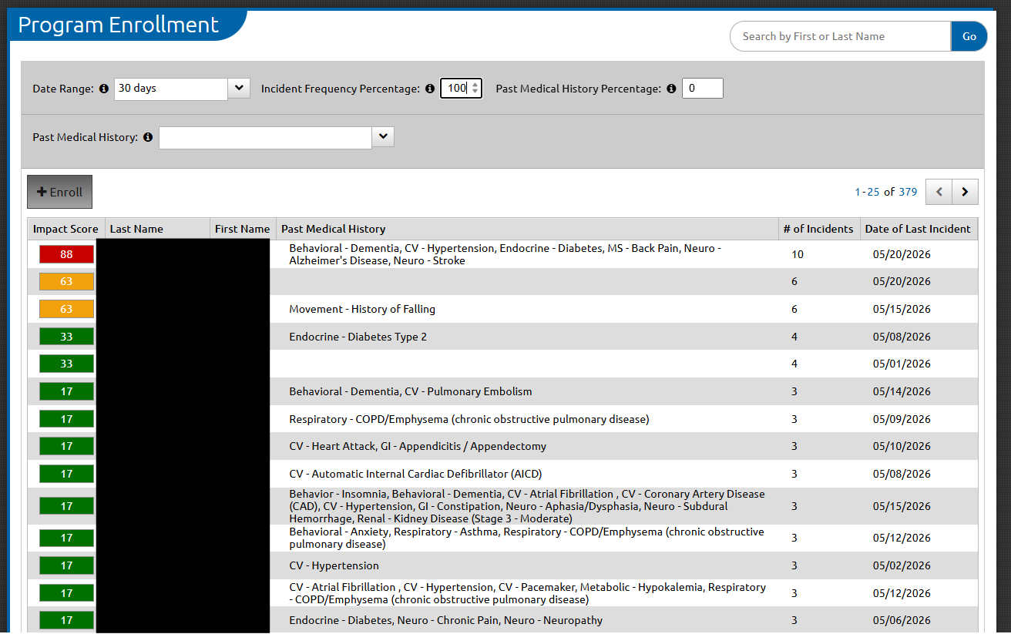
Program overview- Documentation
Image Trend- Electronic Patient Care Records
  Referrals-
  Announcements-
  Community Health module-
    Patient records-
    Enrollment tool-
  Incidents vs. Visits-

Slide 9

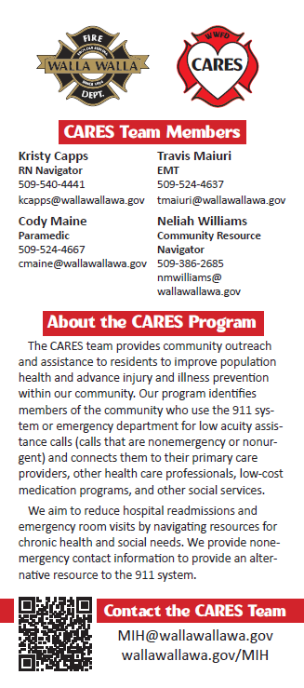
Program Overview- Referrals
Image Trend
Community Partners
City of Walla Walla
Word of mouth
mih@wallawallawa.gov

Slide 10
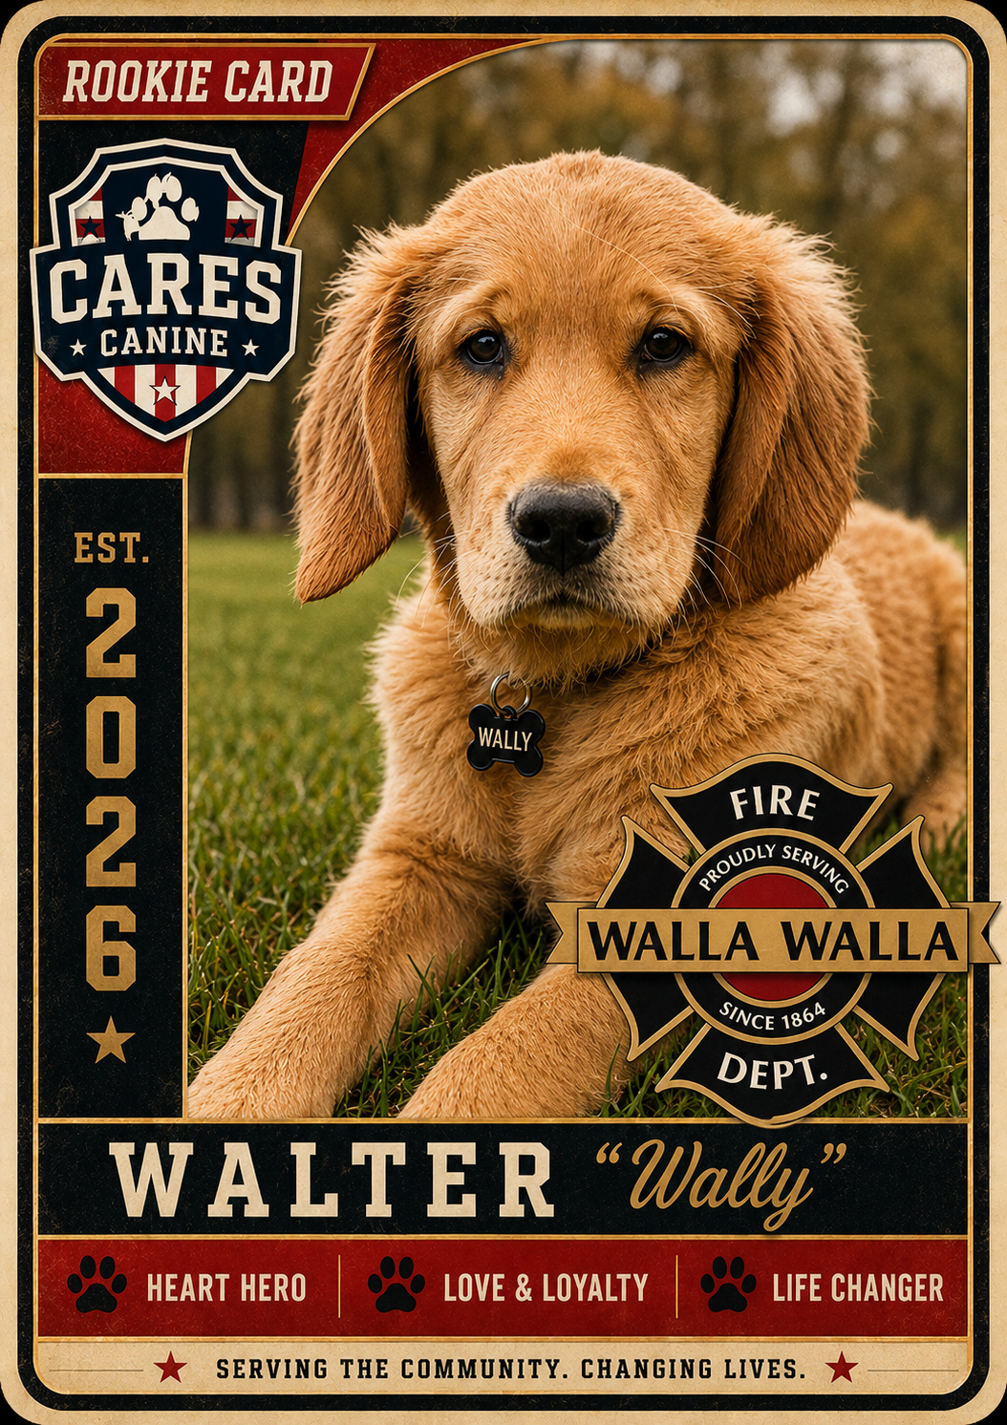
Newest WWFD CARES
Member
Crisis/Community Engagement Canine
Funding by UW BH-CORE Co-Response Fire Innovation Grant
Attending 3 months of Foundational Obedience Training in Eltopia WA
Attending 8 months of Facility/Therapy Dog Training in Eltopia WA
Modeled after Airway Heights Police Department Crisis/Therapy Dog program

Slide 11

We enjoy riders!
mih@wallawallawa.gov

